Slide 1
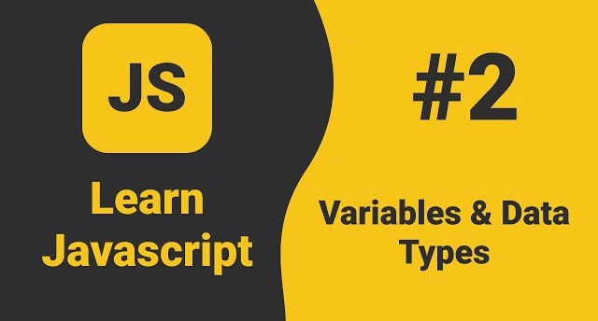

Slide 2
What we Cover Today:
01
02
03
04
05
Data Type
Typeof Operator
Variables
06
Var, Let, Const
String and String Literals Template
Exercise

Slide 3
Data Types and variables
JavaScript has 8 Datatypes:
String
Number
Array (Object)
Boolean
Undefined
Null (object)
Bigint (ES6 or ES 2020)
Symbol (ES6 or ES 2020)

Slide 4
Data Types and variables
String
String are written with quotes. You can use single or double quotes
let color = “Black”;
Let name = ‘Khalid’;
Number
Any number Integer or Float
let length = 16;
Let weight = 7.5;
Let y = 123e5 = 12300000

Slide 5
Data Types and variables
Array
List also is an Object
let scores = [15, 20, 33];
let names = [“Ahmed”, “Yusuf”, “Ali”];
Booleans
Booleans can only have two values: true or false.
Booleans are often used in conditional testing.
let x = true;
Let y = false;

Slide 6
Data Types and variables
undefined
let x;
Null
Empty or unknown value
let x = null;
Object
Collection of data
{ name: "Ali", age: 25 }

Slide 7
Data Types and variables
Typeof Operator
The typeof operator is used to check the data type of a value or variable.
typeof "Hello"; // "string"
typeof 42; // "number"
typeof true; // "boolean"
typeof undefined; // "undefined"
typeof null; // "object"
typeof [1, 2, 3]; // "object"
typeof {name: ”khalid”, Age: ”23”}; // "object"

Slide 8
Data Types and variables
The Concept of Data Types
Let x = 16 + “Books” // 16Books (Number convert into String)
JS evaluates expressions from left to right. Different sequences can produce different results
Let x = 16 + 4 + “Students”; // 20Students
Let x = “Students” + 16 + 4; // Students164

Slide 9
Data Types and variables
Variables
Variables – are containers for storing data values
SYNTAX
Keyword | Variable Name | Assignment Operator | Value;
JavaScript variables can be declared in 4 ways:
Automatically x = 5; y = 6;
Using var name = “Khalid”;
Using let length = 193;
Using const PI = 3.14;

Slide 10
Data Types and variables
Identifiers
All JavaScript variables must be identified with unique names.
These unique names are called identifiers.
Identifiers can be short names (like x and y) or more descriptive names (age, sum, userName (camelCase)).

Slide 11
Data Types and variables
Identifiers
The general rules for constructing names for variables (unique identifiers) are:
Names can contain letters, digits, underscores, and dollar signs.
Names must begin with a letter.
Names can also begin with $ and _
Names are case sensitive (y and Y are different variables).
Reserved words (like JavaScript keywords) cannot be used as names. (var, function, let, etc)

Slide 12
Data Types and variables
Var, Let, Const Compare
Always declare variables
Always use const if the value should not be changed
Always use const if the type should not be changed (Arrays and Objects)
Only use let if you can’t use const
Only use var if you must support old browsers.

Slide 13
Data Types and variables
Var, Let, Const Compare
Feature | var | let | const
Scope | Function-scoped | Block-scoped | Block-scoped
Reassignable | Yes | Yes | No
Redeclarable | Yes | No | No
Global Object | Yes (window.var) | No | No
Access Before Declare | Undefined | Error | Error

Slide 14
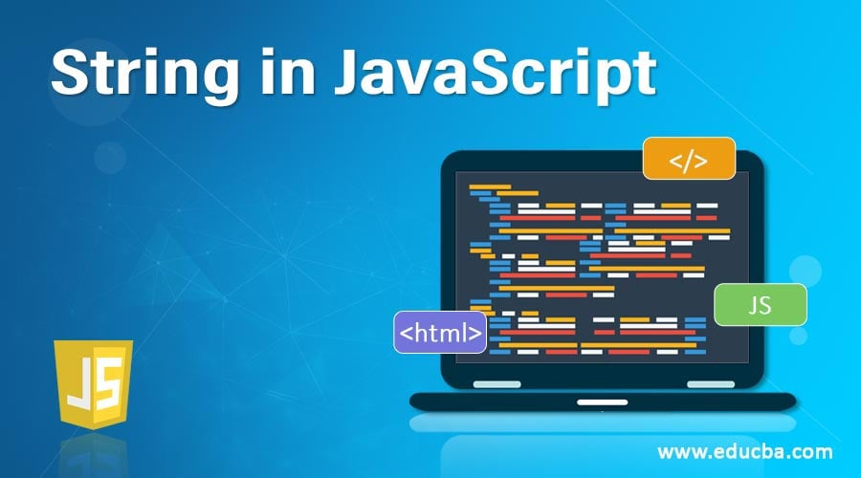

Slide 15
String
Strings are for storing text
Strings are written with quotes
Example:
let text = “Mohamed”;
You can use single or double quotes:
let myName = “Khalid”;
let myName = ‘Khalid’;

Slide 16
String
Escape Characters
Because strings must be written within quotes, JavaScript will misunderstand this string:
Let live = “We live in “Somaliland””;
The string will be chopped to "We live in".
To solve this problem, you can use an backslash escape character.
The backslash escape character (\) turns special characters into string characters:

Slide 17
String
Escape Characters
Code | Result
\' | '
\" | "
\\ | \
\n | New Line
\t | Horizontal Tabulator

Slide 18
String Literals Template
A string template in JavaScript is a new way to write text (string).
It uses backticks ` (not quotes ' ").
It is easier to:
Write long text (many lines).
Put variables inside text.
Example 1: Normal String
let name = "Khalid";
let text = "Hello, my name is " + name + ".";
console.log(text);
This is a bit hard because we must use + to join words.

Slide 19
String Literals Template
Example 2: String Template
let name = "Khalid";
let text = `Hello, my name is ${name}.`;
console.log(text);
Much easier no + we use ${variable} inside `
Example 3: Multi line text
let poem = `Roses are red
JavaScript is fun
And easy for you!`;
console.log(poem); We can write on many lines without \n

